Slide 1
“The Internet of Things is about creating a smarter, more connected world, where devices can communicate with each other to make our lives easier and more efficient.”
~Eric Schmidt, Executive Chairman of Alphabet (Google)

Slide 2

Smart Gas Leakage System
Neaz Mahmud
Shihab Ud Doula
Yunsook Choi

Slide 3
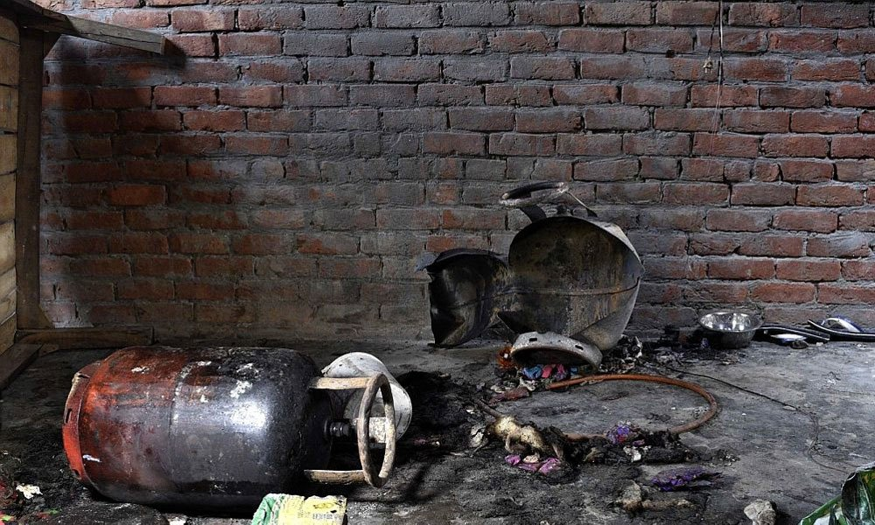

Introduction
International for Fire & Rescue Services-2020
24.2% in residential budlings
82% death only in residential budlings
Average 20 incidents per 1000 inhabitants

Slide 4

Objective
An IOT system that can monitor gas leakage and spot potential fires.
Hardware :
Arduino Uno Wi-Fi Rev 2
Raspberry Pi 3
Sensors and Actuators ( MQ4 Gas, Flame sensor ,LED,Piezo buzzer)
Software:
Arduino Uno IDE
Raspberry Pi Imager

Slide 5
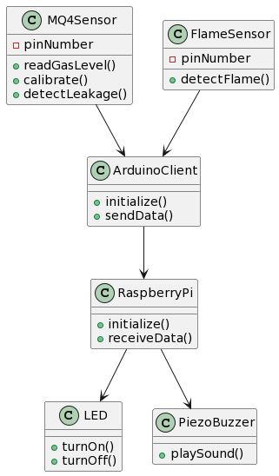
Class Diagram/Use Case Diagram

Slide 6
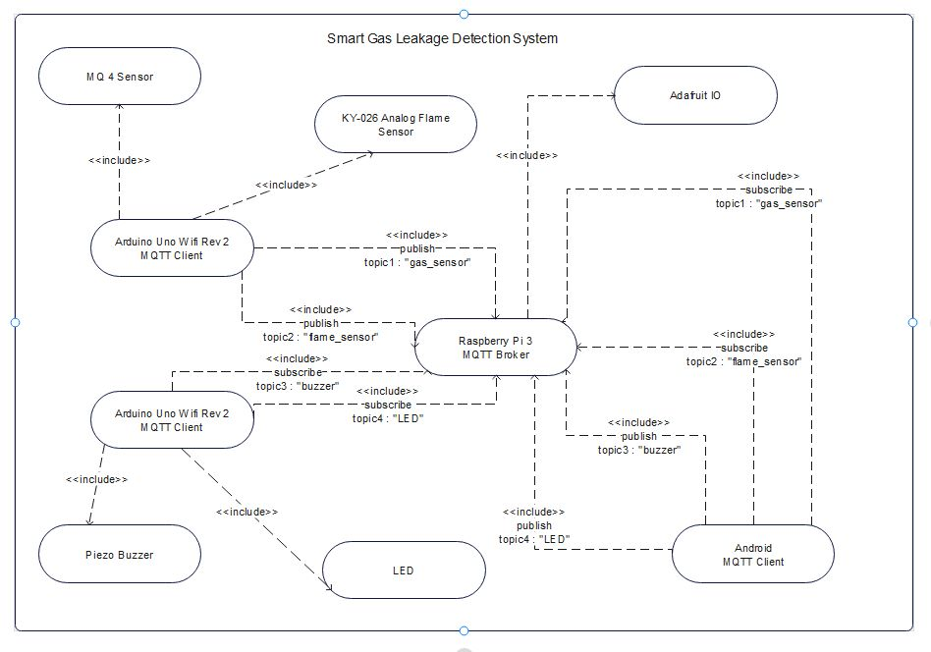
System Framework
Block Diagram

Slide 7

Initial Task To Final Rendition
Programming Arduino for Sensor reading
Programming Arduino for Actuator control
Simultaneous Iterations
Raspberry PI as MQTT broker

Slide 8
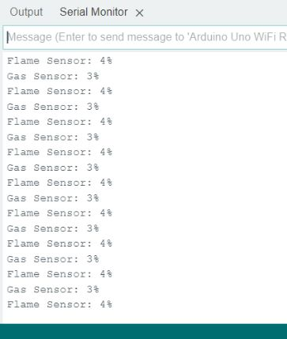
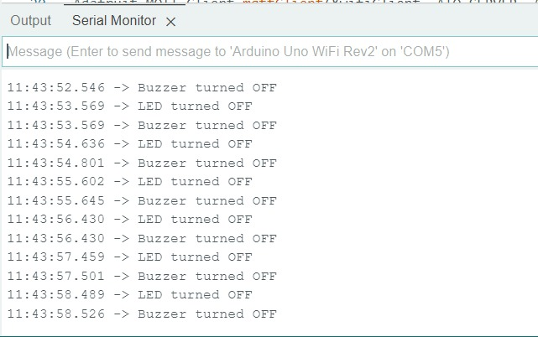
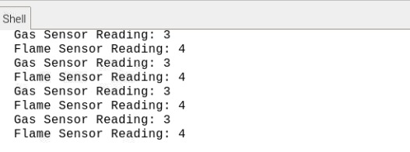
OutPut

Slide 9
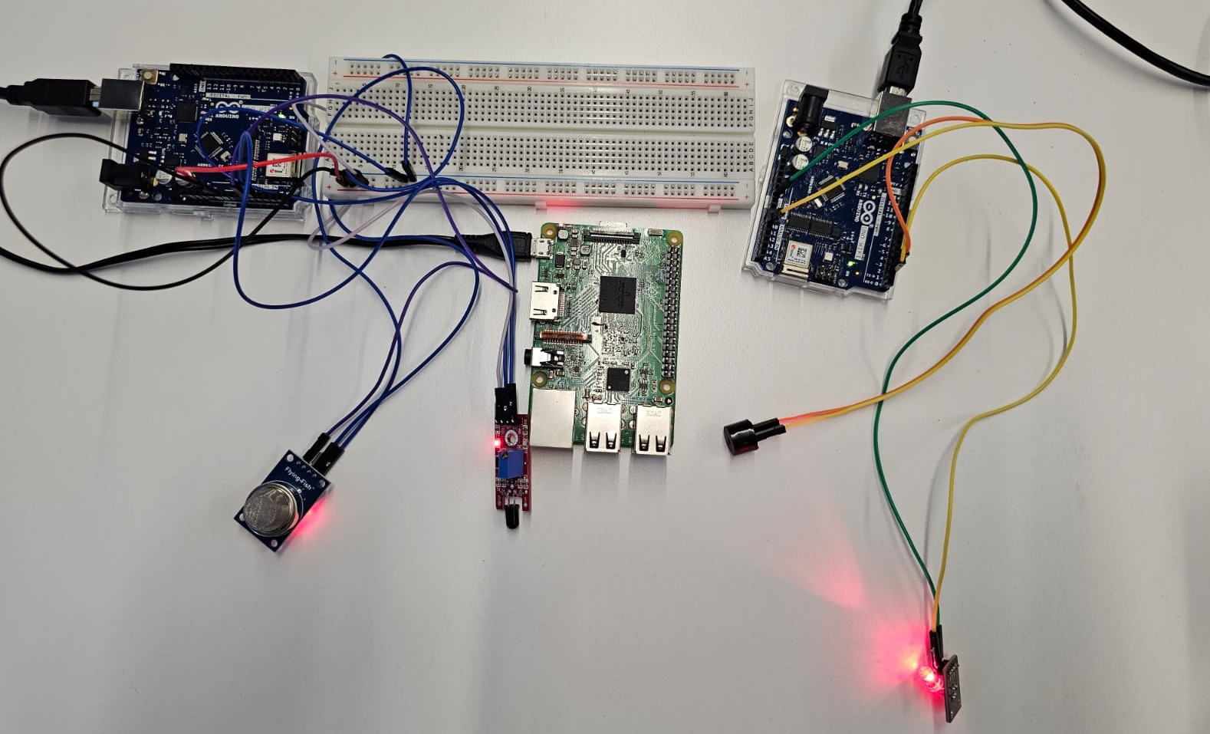
System Visualization

Slide 10
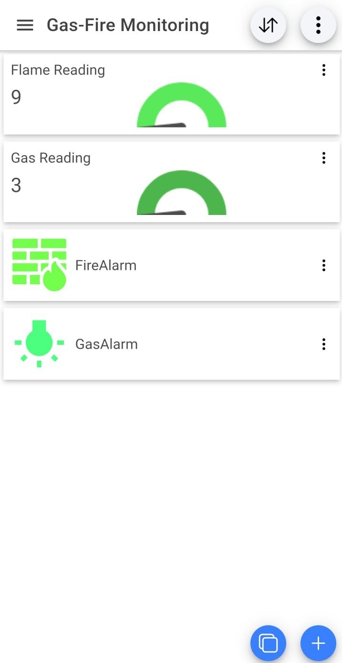

Slide 11
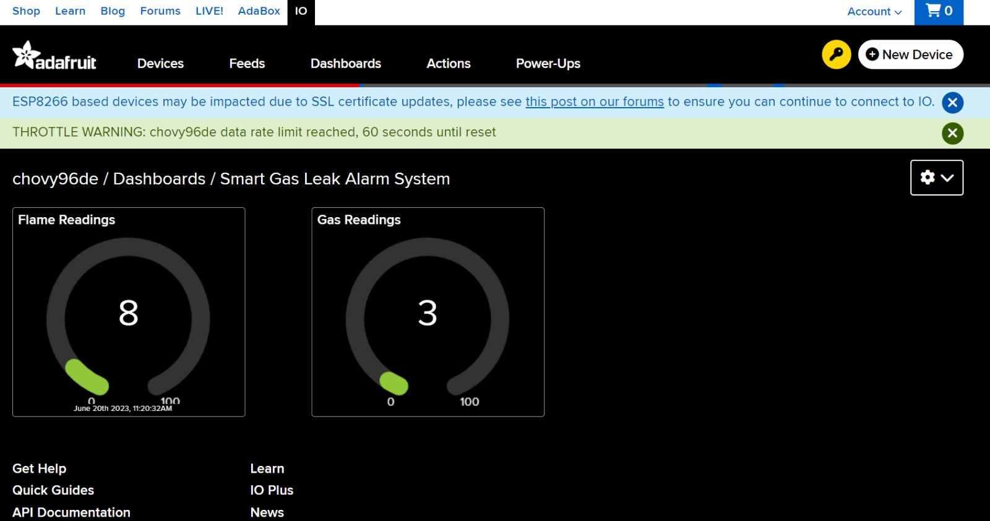
Adafruit IO

Slide 12

Challenges

Slide 13
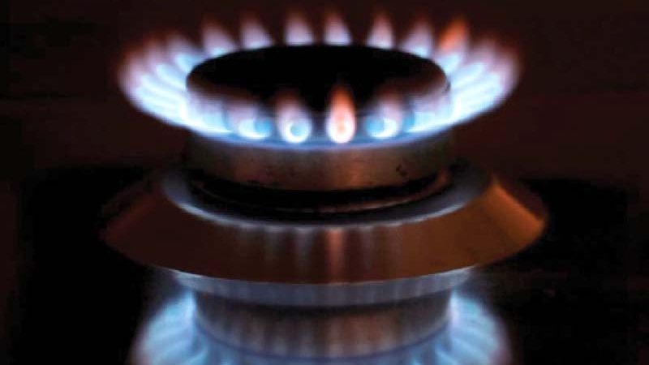
Conclusion

Slide 14
References
Adhikary, T. S. (2021, June 28). Gas leaks 4th most blamed for fires. The Daily Star. https://www.thedailystar.net/bangladesh/news/gas-leaks-4th-most-blamed-fires-2120013
Ommcom News. (2021). Delhi: Cylinder Blast Kills Woman, 4 Kids Injured. Odisha News, Odisha Breaking News, Odisha Latest News. https://ommcomnews.com/india-news/delhi-cylinder-blast-kills-woman-4-kids-injured
One in five fire accidents linked to gas leakage. (n.d.). New Age | the Most Popular Outspoken English Daily in Bangladesh. https://www.newagebd.net/article/115736/one-in-five-fire-accidents-linked-to-gas-leakage
Uno Wifi Rev2 SDS011 compatibility. (2019, April 5). Arduino Forum. https://forum.arduino.cc/t/uno-wifi-rev2-sds011-compatibility/584209

